Slide 1

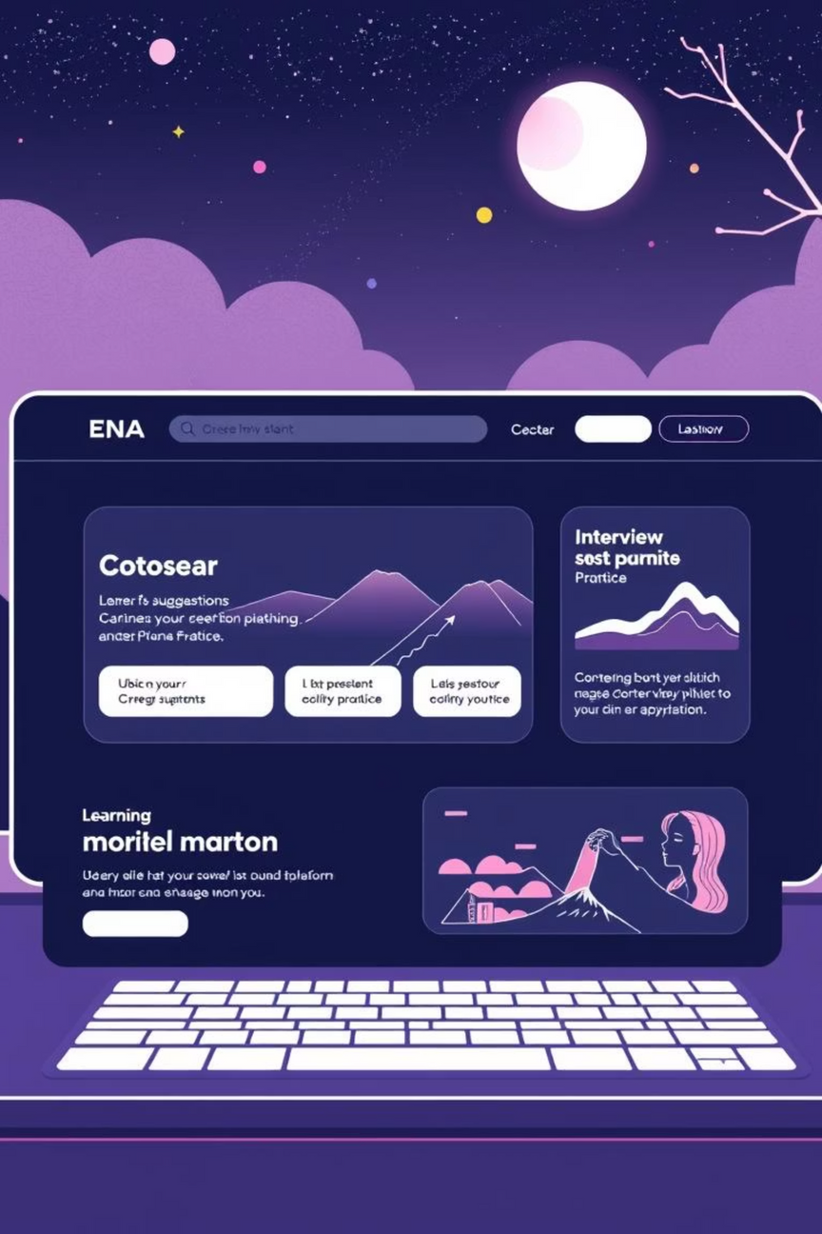

SysBot – AI Career Studio
Your AI-Powered Career Companion
A web-based platform that guides students and professionals with AI-driven career suggestions, learning roadmaps, and interview practice.
Notes:
1

Slide 2
Problem Statement
Difficulty identifying the right career path
Lack of structured learning resources
Limited access to realistic interview practice
Existing solutions are fragmented, expensive, or not personalized.
Notes:
2

Slide 3
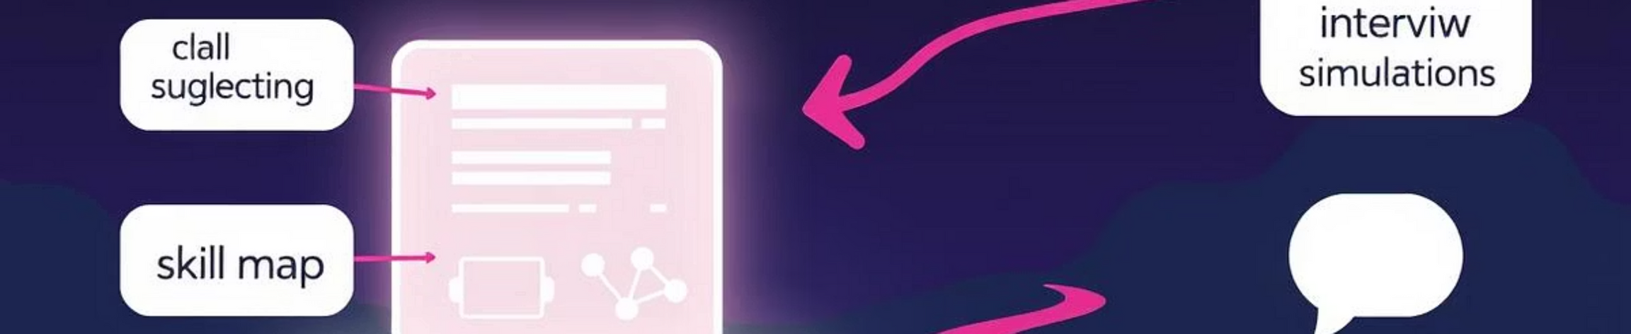
Proposed Solution
Introduction to SysBot as an AI-driven career guidance platform
Integrates career suggestions, skill mapping, personalized learning roadmaps, chat and voice-based interview simulations.
Provides a holistic, accessible, and scalable solution.
Notes:
3

Slide 4
Key Features
Career Discovery
Chat-Based Mock Interviews
Upload resume or enter skills to receive personalized career suggestions.
AI-driven text interview practice with instant feedback.
Voice-Based Mock Interviews
Personalized Guidance
Realistic spoken interview simulation with follow-up questions.
Matches skills to relevant career paths and learning resources.
24/7 Accessibility
Privacy-Focused
Cloud-based, available anytime.
Secure handling of personal data.
Notes:
4

Slide 5

System Architecture / Process Flow Diagram
User Input
Frontend
Backend
AI Engine
Notes:
5

Slide 6





Technology Stack
Frontend
Backend
AI Engine
React
Vercel serverless API functions
Google Gemini API for text generation
Voice
Deployment
Web Speech API (Speech-to-Text) and Speech Synthesis API (Text-to-Speech)
Vercel cloud hosting
Notes:
6

Slide 7
Unique Selling Proposition (USP)
All-in-One Solution
Career discovery, skill development, interview practice
AI-Powered Personalization
Adaptive guidance based on skills and profile
Realistic Interview Simulation
Chat and voice modes
Cloud-Based and Scalable
Accessible anytime, minimal infrastructure
Privacy-Focused and Cost-Effective
Free to use, secure
Notes:
7

Slide 8
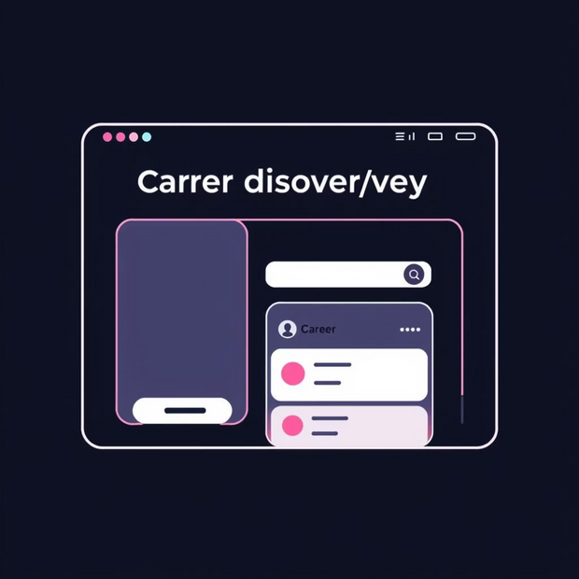

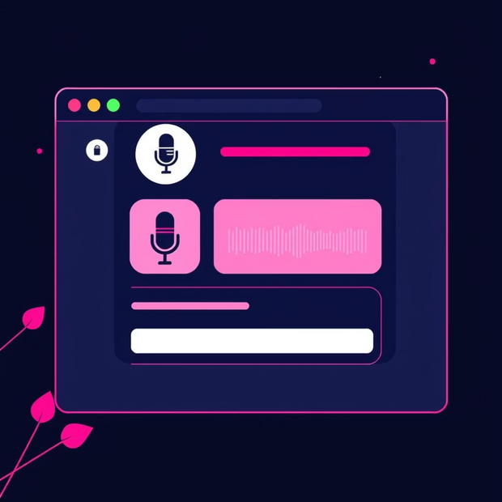
Wireframes / Mockups
Visual representation of three tabs:
Career Discovery
Chat Interview
Voice Interview
Notes:
8

Slide 9
Impact and Benefits
Time and Cost Savings
Structured Learning
Saves time and cost compared to traditional counseling
Provides structured, personalized learning roadmaps
Improved Readiness
Universal Accessibility
Improves interview readiness and confidence
Accessible anywhere, anytime
Notes:
9

Slide 10
Future Scope
Integration with LinkedIn and job portals
Multi-language support for global reach
Advanced analytics for career progress tracking
AI-driven mentorship pairing
Conclusion
Summary of SysBot as a comprehensive AI career companion
Highlights innovation, usability, and impact
Notes:
10

